Slide 1

Fantastic “ClassFactory” and where to find it.
Mykyta Lytvynenko

Slide 2
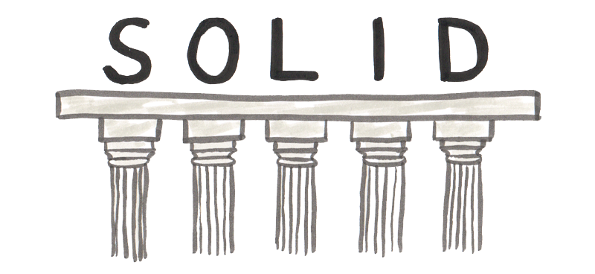
S (Single-responsiblity principle) - One class should have one and only one responsibility
O (Open-closed principle) - Objects or entities should be open for extension, but closed for modification.
L (Liskov substitution principle) - Derived types must be completely substitutable for their base types.
I (Interface segregation principle) - Clients should not be forced to depend upon interface members they do not use. In other words, do not force any client to implement an interface that is irrelevant to them.
D (Dependency Inversion Principle) - Entities must depend on abstractions not on concretions.

Slide 3
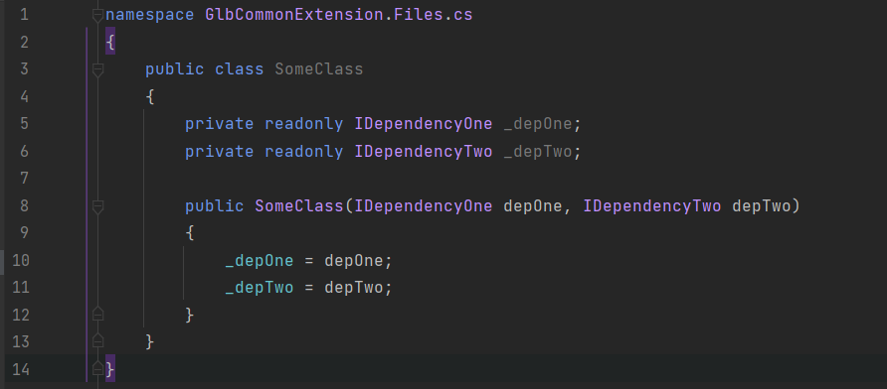
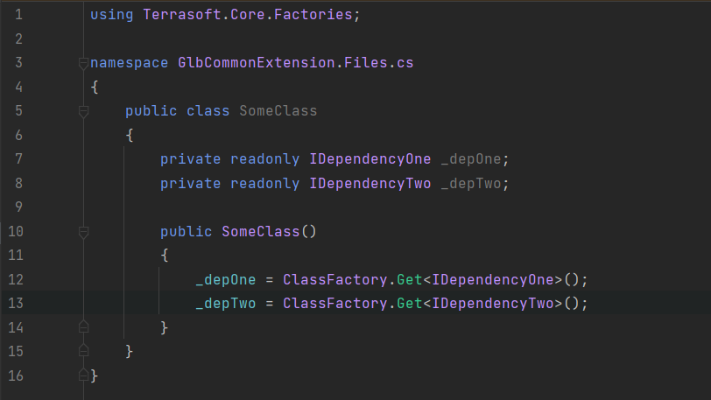
How to break dependency?
DEPENDENCY INJECTION
SERVICE LOCATOR PATTERN
Constructor injection, property injection, method injection

Slide 4
Dependency injection
Pure DI – without frameworks/libraries
Ninject – we use this one
Simple injector
Autofac
Windsor Castle

Slide 5
Samples
Notes:
Rebind? Передача параметрів в конструктор ConstructorArgument
Лайв демо, додавання нової функціональності.

Slide 6
Use cases
Override existing classes
Strategy pattern
Unit testing
Development in solution

Slide 7

Questions?

